Slide 1



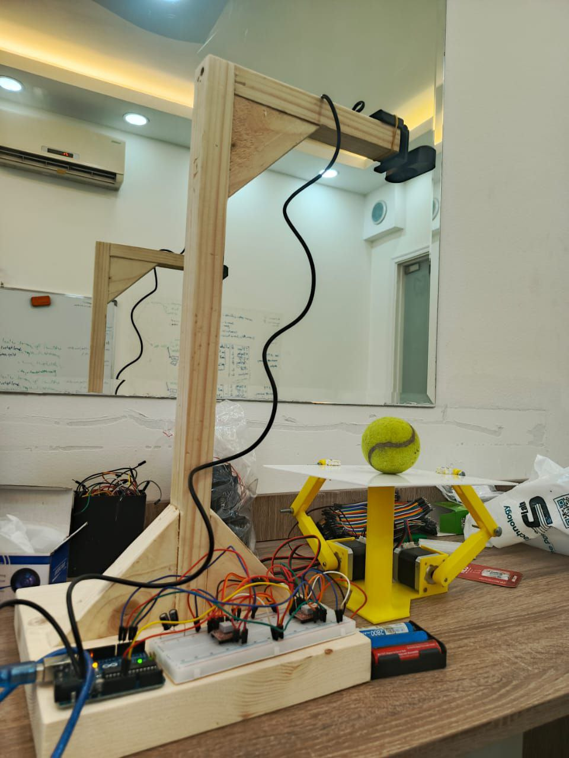
Lebanese University
Faculty of Engineering III
Electrical and Electronic Department
BALL BALANCING
Students: Rawad Fakhreddine 6366
Aya Kreij 6497
Supervisor: Prof. Mohamad Aoude
Notes:
Hello and welcome to our presentation on the Ball Balancing Platform Project using Computer Vision, Reinforcement Learning, and Arduino-controlled motors.
This innovative project was completed by Rawad Fakhreddine and Aya Kreij, under the supervision of Prof. Mohamad Aoude at the Lebanese University – Faculty of Engineering III.

Slide 2
TASKS OF THE PROJECT
Fine-tuned a YOLOv8 with a dataset to detect the tennis ball
Use Computer Vision to detect and track the ball
Compute the position, velocity, and acceleration of the ball
Print the equipment and linkage using 3D Printing
First try: Use a PID Controller to balance the ball
Second try: Use Reinforcement Learning to train a model (agent)
Calculate the linkage function to transform the tilt angle of the table to the necessary angle of rotation of each stepper motor
Send Data from VS Code to Arduino via serial port
Initialize the 2 stepper motors, and calculate the necessary steps using angle of rotation
1
Notes:
The main goals of this project are:
To detect and track a tennis ball in real time using YOLOv8 and a webcam.
To calculate the ball’s position, velocity, and acceleration.
To train a Reinforcement Learning agent that can learn to stabilize the ball on the platform.
And finally, to control stepper motors using Arduino and a custom mechanical linkage system to tilt the platform

Slide 3
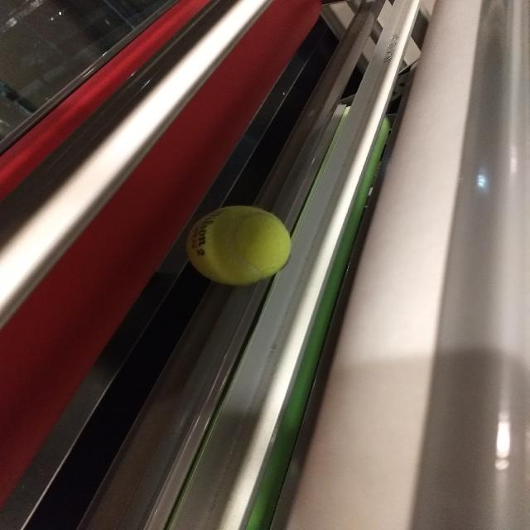
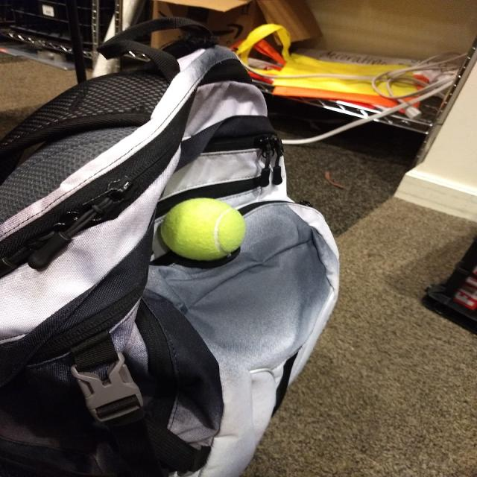
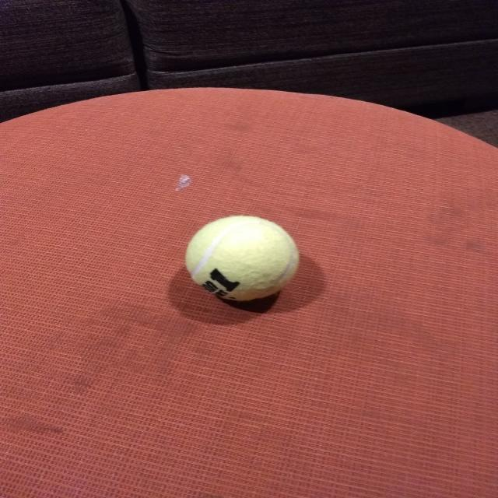
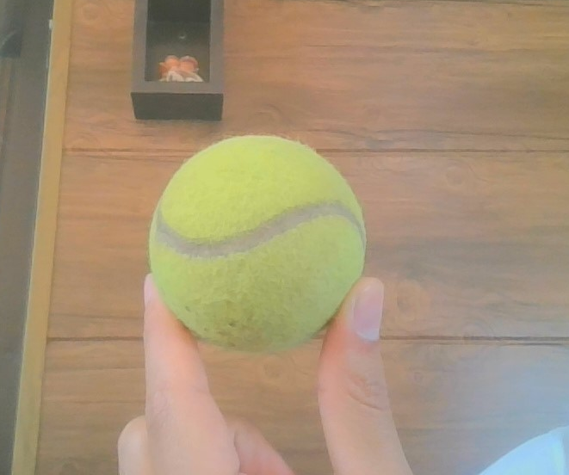
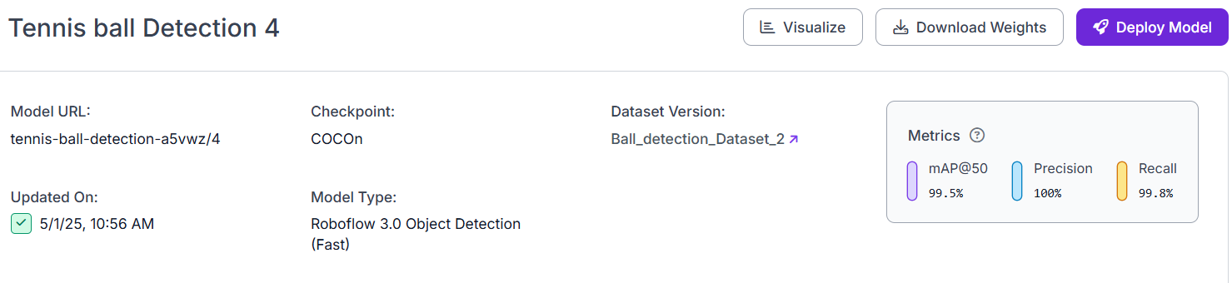
FINE-TUNED A YOLOV8
You Only Look Once Object detection algorithm that can find and identify objects
YOLOv8 is for general-purpose datasets, we fine-tune it to detect the tennis ball only by training it on a custom dataset
Different lighting conditions
Varying positions and angles
Having some clutter in the background
2
Notes:
Computer Vision Module: A YOLOv8 model detects the ball’s location from webcam frames. These image coordinates are then converted into real-world positions using a pixel-to-centimeter conversion factor.

Slide 4
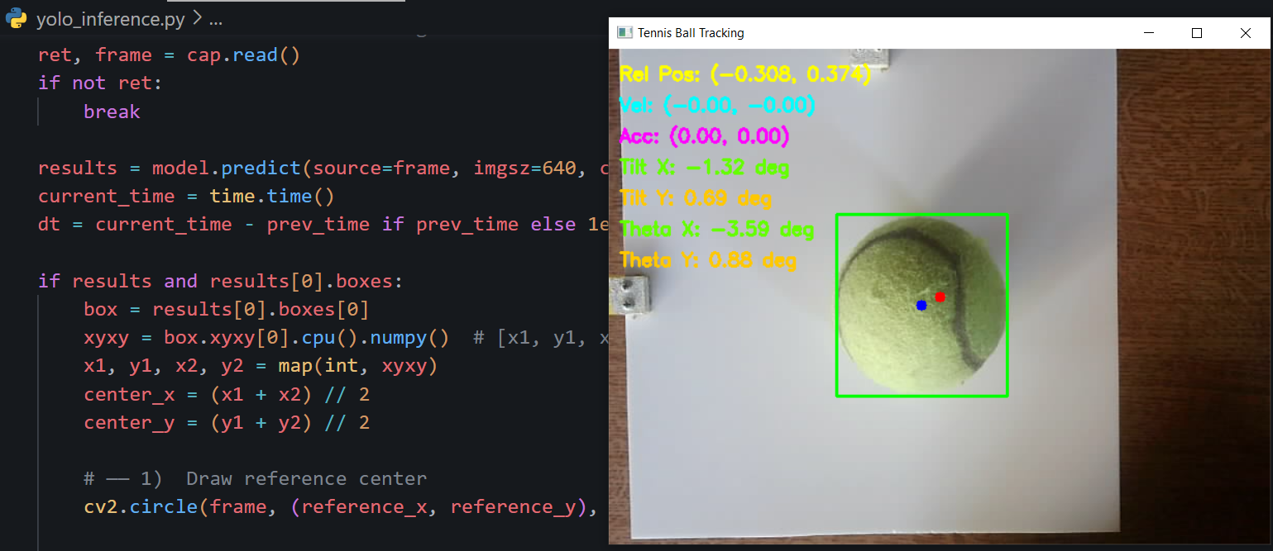
Detect and track the ball in real life using a webcam
Computer captures frames
Run YOLOv8 interference on the frame
YOLOv8 outputs bounding boxes
Calculating the center of the platform/table (red point)
Calculating the center of the tennis ball by finding the 4 borders (blue point)
These are the ball’s coordinates in the camera’s image frame (in pixels)
COMPUTER VISION
3
Notes:
State Estimation: The ball’s velocity and acceleration are estimated by comparing positions over time. To reduce noise, we applied exponential smoothing and a deadband filter.

Slide 5
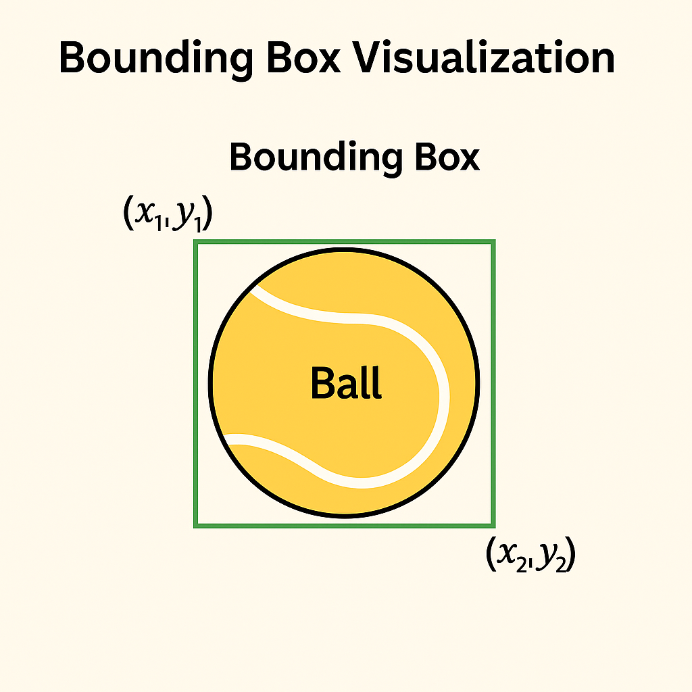
4
Notes:
Calculate the center of the ball by detecting it’s edge

Slide 6
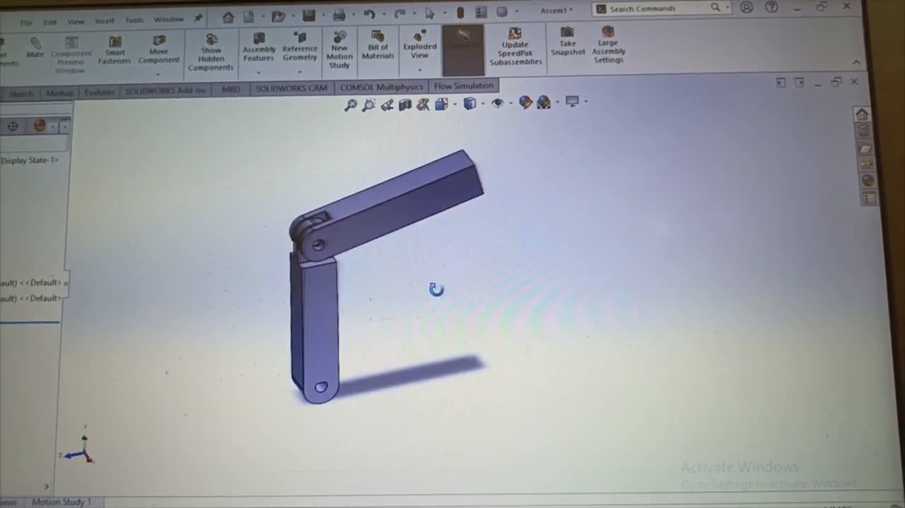
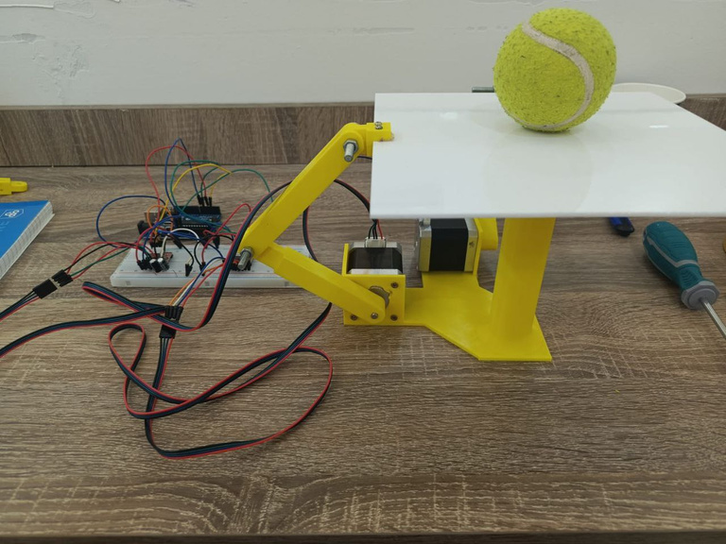
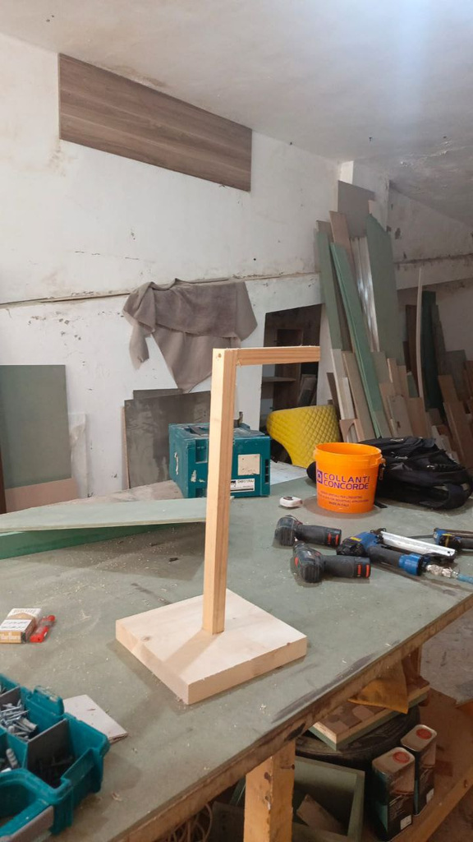
PRINT THE EQUIPMENT AND LINKAGE USING 3D PRINTING
Design the equipment using SolidWorks
Print it with a 3D Printing machine
Print the linkage and the structure of the project
Join all the linkages with the structure
Used a Flexy with a 20cm width for the table
Design a wooden stand for the camera
5
Notes:
We Design the equipment using SolidWorks. Print the parts using a 3D printing.And finally, Join and construct the project

Slide 7
The necessary rotation angle
Y-axis
Θx –
Θy –
Postion of the ball:
Θx +
Θy –
(-,-)
(+,-)
X-axis
Θx –
Θy +
Θx +
Θy +
(-,+)
(+,+)
6
Notes:
This is a clear slide that show how the stepper motors should act in different cases of position of the ball

Slide 8
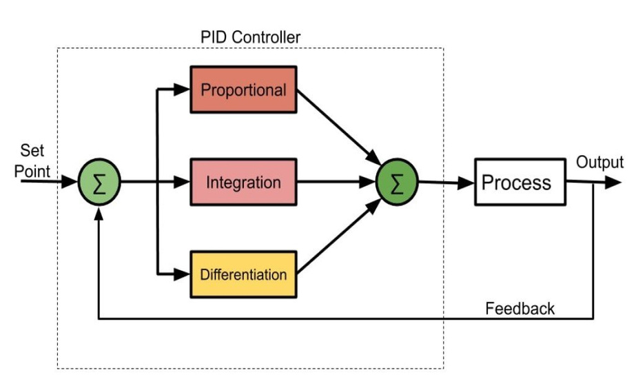
FIRST TRY: PID CONTROLLER
Compute the error = reference - position of the ball
Uses the PID equation (for x & y): pid_x = (Kp * err_x) + (Ki * int_x) - (Kd * vel_mps[0])
The output should be theta 4, which is the necessary tilt angle (x & y) of the table
The PID is in a loop, where the errors are always updating due to feedback
Because we don’t have the transfer function so it’s very hard to solve this problem using a PID Controller!
7
Notes:
We first attempted to control the ball using a PID controller. Although the PID worked under simple conditions, it failed in many edge cases due to the nonlinear nature of the system.

Slide 9
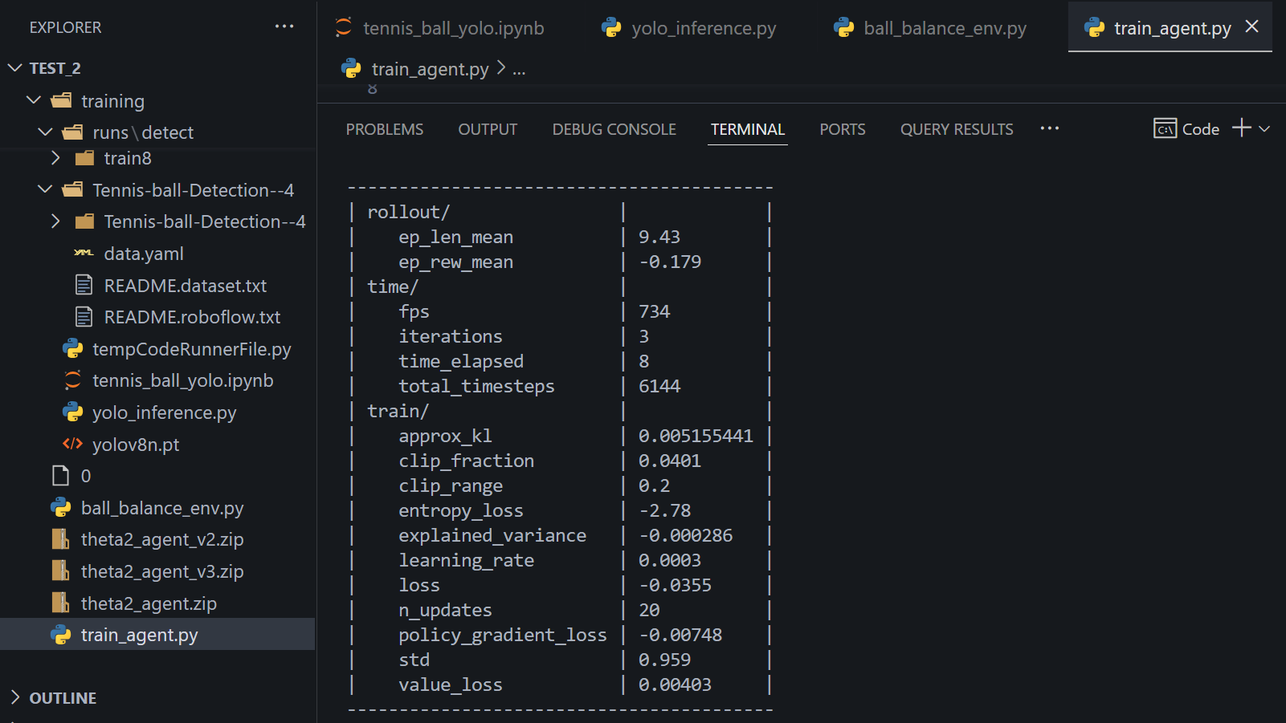
SECOND TRY: USE REINFORCEMENT LEARNING
There are many versions of models. Each time, I am trying to improve the agent by giving more features and details, and trying to think of different cases. In the last version, I changed the training loop to increase difficulty gradually. The output is theta 4 (the necessary tilt table to balance the ball)
It gives a good result for the tilt angles of the table!
8
Notes:
We then switched to Reinforcement Learning. The agent was trained in simulation and gradually introduced to harder starting conditions using curriculum learning. After training, the agent successfully learned how to keep the ball centered by producing smooth and adaptive tilt commands.

Slide 10
REINFORCEMENT LEARNING AND AGENT
Ball_balance_env file:
This file defines the custom Gymnasium environment that simulates the dynamics of a ball on a tilting table. It provides the physical world in which the agent operates.
Simulates ball motion based on table tilt (θ4_x, θ4_y)
Computes observations: ball position and velocity
Provides rewards that penalize being far from the center or moving fast
Terminates episode if ball falls off the table or max steps are reached
Supports curriculum learning by adjusting the spawn difficulty.
Train_agent file:
This script creates and trains a reinforcement learning agent using the PPO algorithm from Stable-Baselines3. The agent interacts with the environment and learns how to balance the ball by tilting the table
Imports the custom environment
Trains the agent using model.learn(...)
Uses a curriculum strategy: trains progressively on 5 increasing difficulty levels
At each level, a new environment is created with greater initial ball displacement.
Saves the trained agent model for later use
9
Notes:
The file Ball_balance_env defines the custom Gymnasium environment that simulates the dynamics of a ball on a tilting table. It provides the physical world in which the agent operates. The Train agent script creates and trains a reinforcement learning agent using the PPO algorithm from Stable-Baselines3. The agent interacts with the environment and learns how to balance the ball by tilting the table

Slide 11

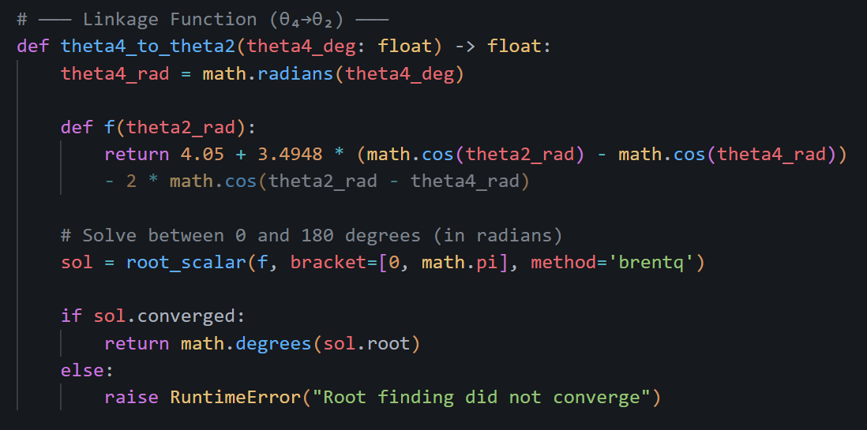
Linkage Function
The Linkage Equation: It’s a nonlinear equation. comes from mechanism kinematics, particularly four-bar linkage theory, which is a classical topic in mechanical engineering. In our project, we use Brent's Method to solve it
Brent’s method is a root-finding algorithm that combines:
Bisection method (safe, slow)
Secant method (faster, no derivative)
Inverse quadratic interpolation (even faster)
10
Notes:
The Linkage Equation: It’s a nonlinear equation. comes from mechanism kinematics, particularly four-bar linkage theory, we solve it using root_scalar

Slide 12
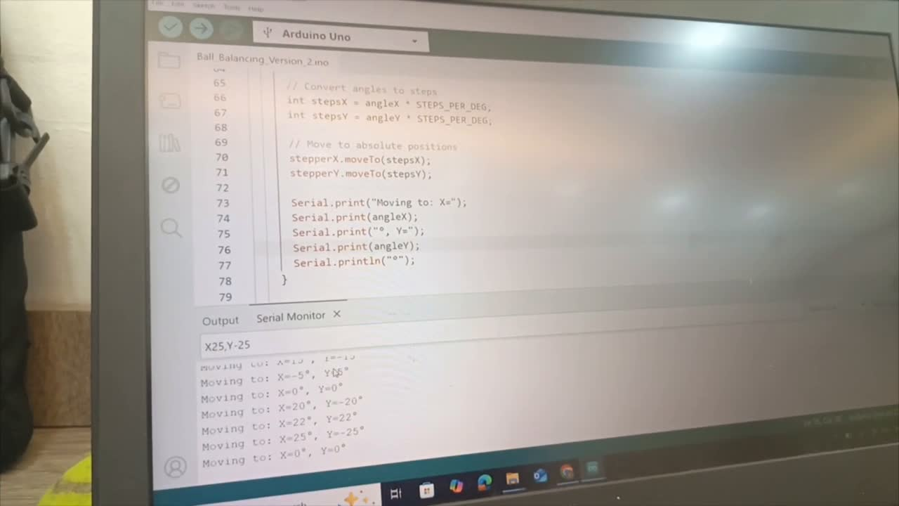
SERIAL PORT
TRANSFORM DATA FROM VS CODE TO ARDUINO:
#Format as string
data_str = f"X{theta2_x:.2f},Y{theta2_y:.2f}\n"
ser.write(data_str.encode()) # Send as bytes
time.sleep(0.05)
VS CODE
// Capture serial data
void serialEvent() {
while (Serial.available()) {
char inChar = (char)Serial.read();
if (inChar == '\n') {
stringComplete = true;
} else {
inputString += inChar; }}}
ARDUINO IDE
11
Notes:
Once the tilt angles are computed, they’re sent to the Arduino via serial communication.

Slide 13
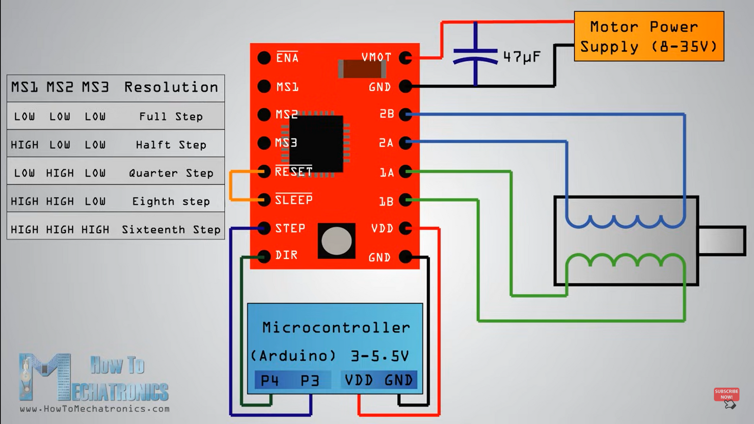
Arduino Circuit
Equipment:
Arduino Uno
2 stepper motors
2 A4988 Drivers
Connection leads
Power supply
A stepper motor is a brushless DC electric motor that divides a full rotation into a number of equal steps, providing precise control over the motor's position and speed.
12
Notes:
The Arduino parses the command, converts the angles into motor steps, and uses the AccelStepper library to smoothly move the motors.

Slide 14
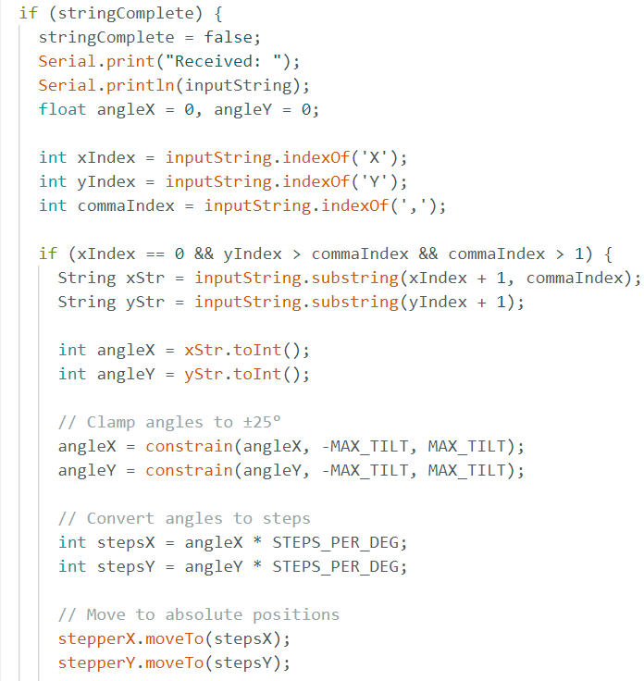
Arduino Code
Put conditions for the stepper motor's rotation to keep the linkage safe
Transform the angle of rotation to steps, every 200 steps is a 360-degree rotation
The moveTo function can move the motor to the desired angle, where the position is absolute, the reference is (0,0)
10
Notes:
A full 360-degree rotation equals 200 steps — so we calculate the number of steps based on the desired angle and execute the motion accordingly.
To ensure safety, we added tilt limits and clamped angles to within ±25 degrees

Slide 15
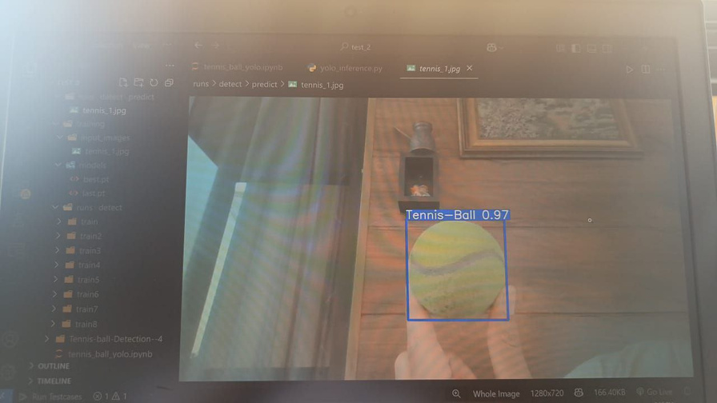
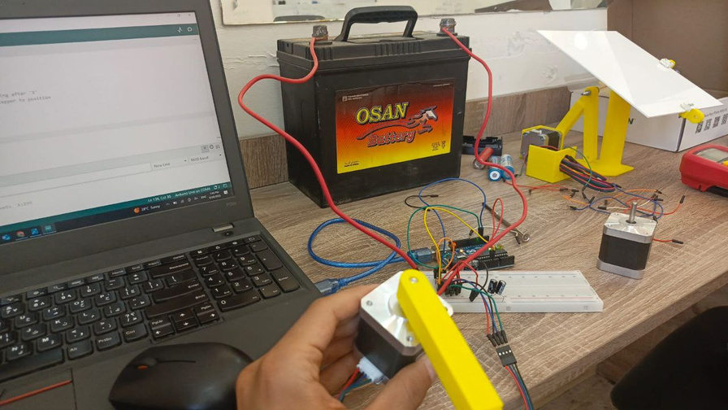
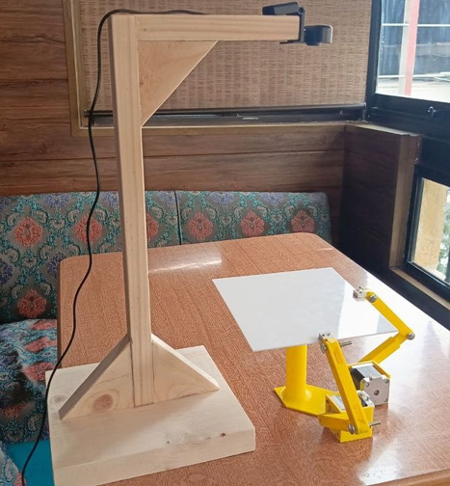
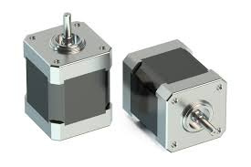
THIS WAS OUR BALL BALANCING PROJECT
THANK YOU
FOR WATCHING
Notes:
This project demonstrates that Reinforcement Learning, when combined with vision-based control and Arduino motor actuation, can effectively stabilize a dynamic system like a ball-on-plate — entirely without classical modeling or manual tuning.
The trained agent was able to transfer from simulation to hardware, showing the power of data-driven control in physical systems.
We hope this project inspires others to explore intelligent control techniques in real-world robotics and automation.
Thank you for listening.

